Slide 1
Small and Local Business are finding it harder than ever to survive and grow.

Slide 2
It's no secret that big companies have the budgets and power
to eat up market share.

Slide 3


However...
what we believe is the biggest game changer for local businesses has now been made available.

Slide 4
AI or Artificial Intelligence
is the great leveller. And with ChatGPT you now have access to the same power as any other company
no matter it's size.

Slide 5
In today's fast-paced digital landscape, staying ahead of the competition and delivering exceptional customer experiences is crucial for every business.

Slide 6
Introducing our cutting-edge digital services agency, revolutionizing the way businesses engage with their customers –
with the power of ChatGPT.

Slide 7
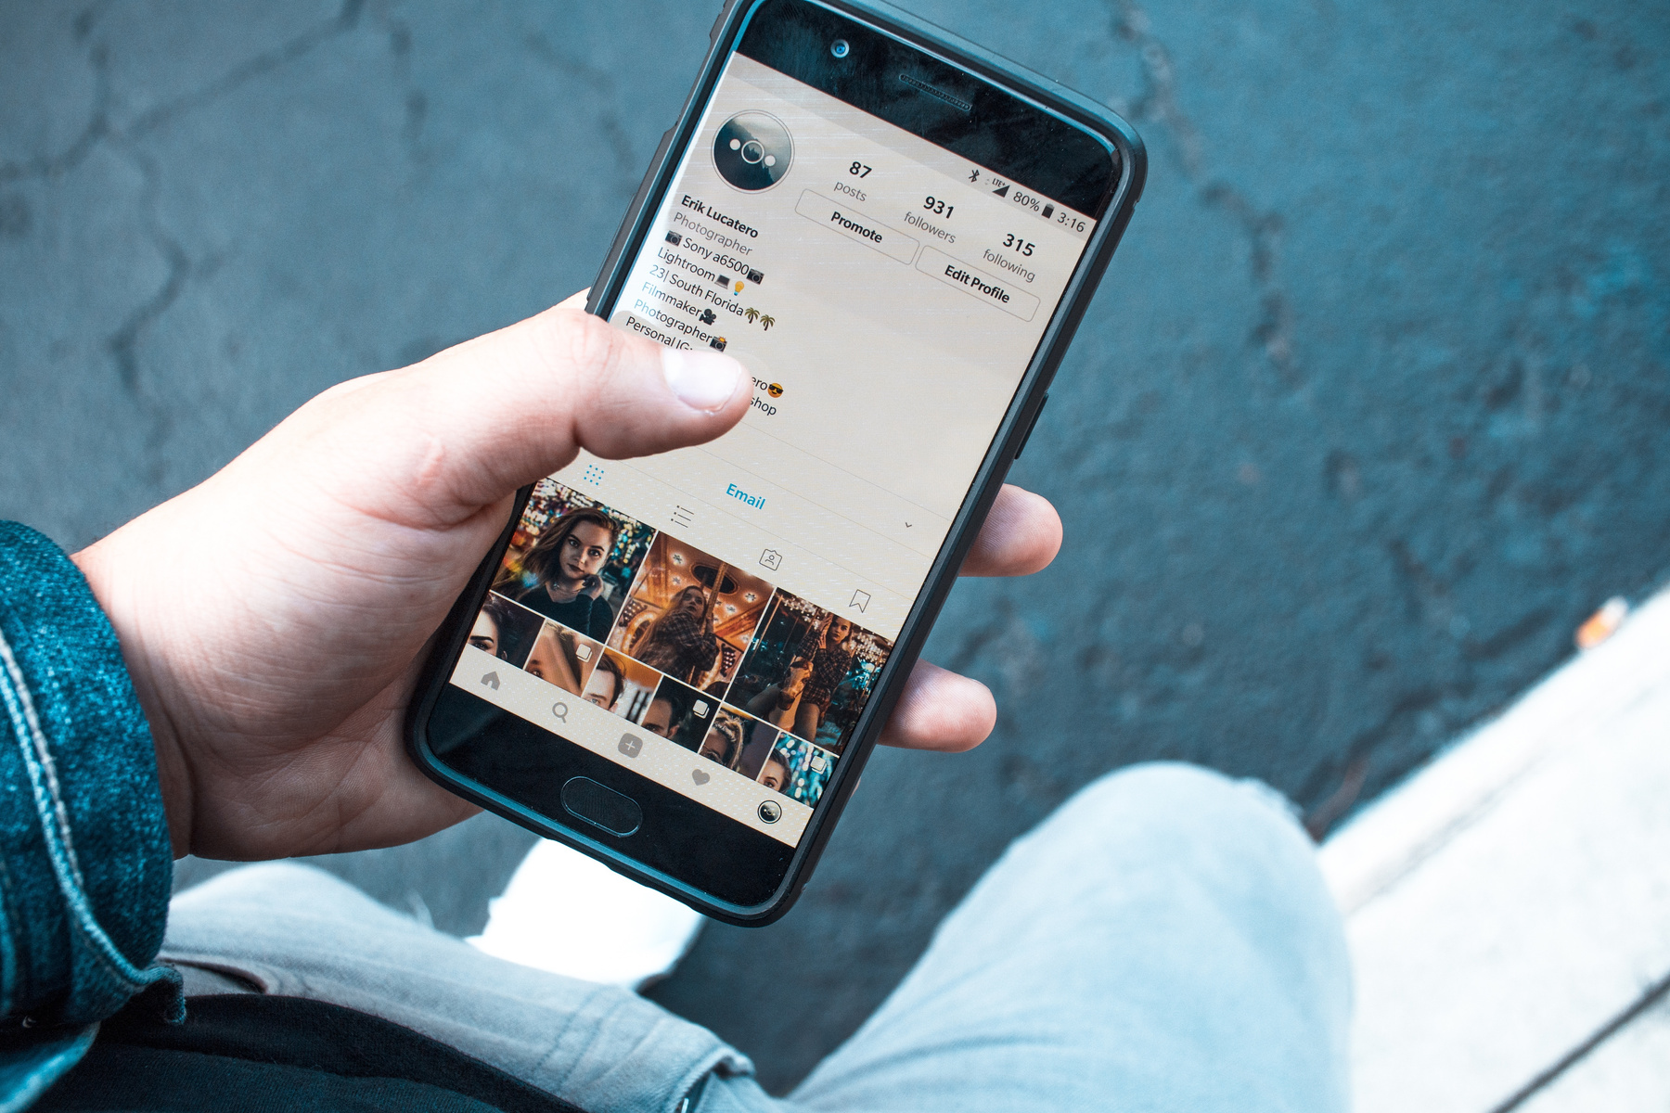
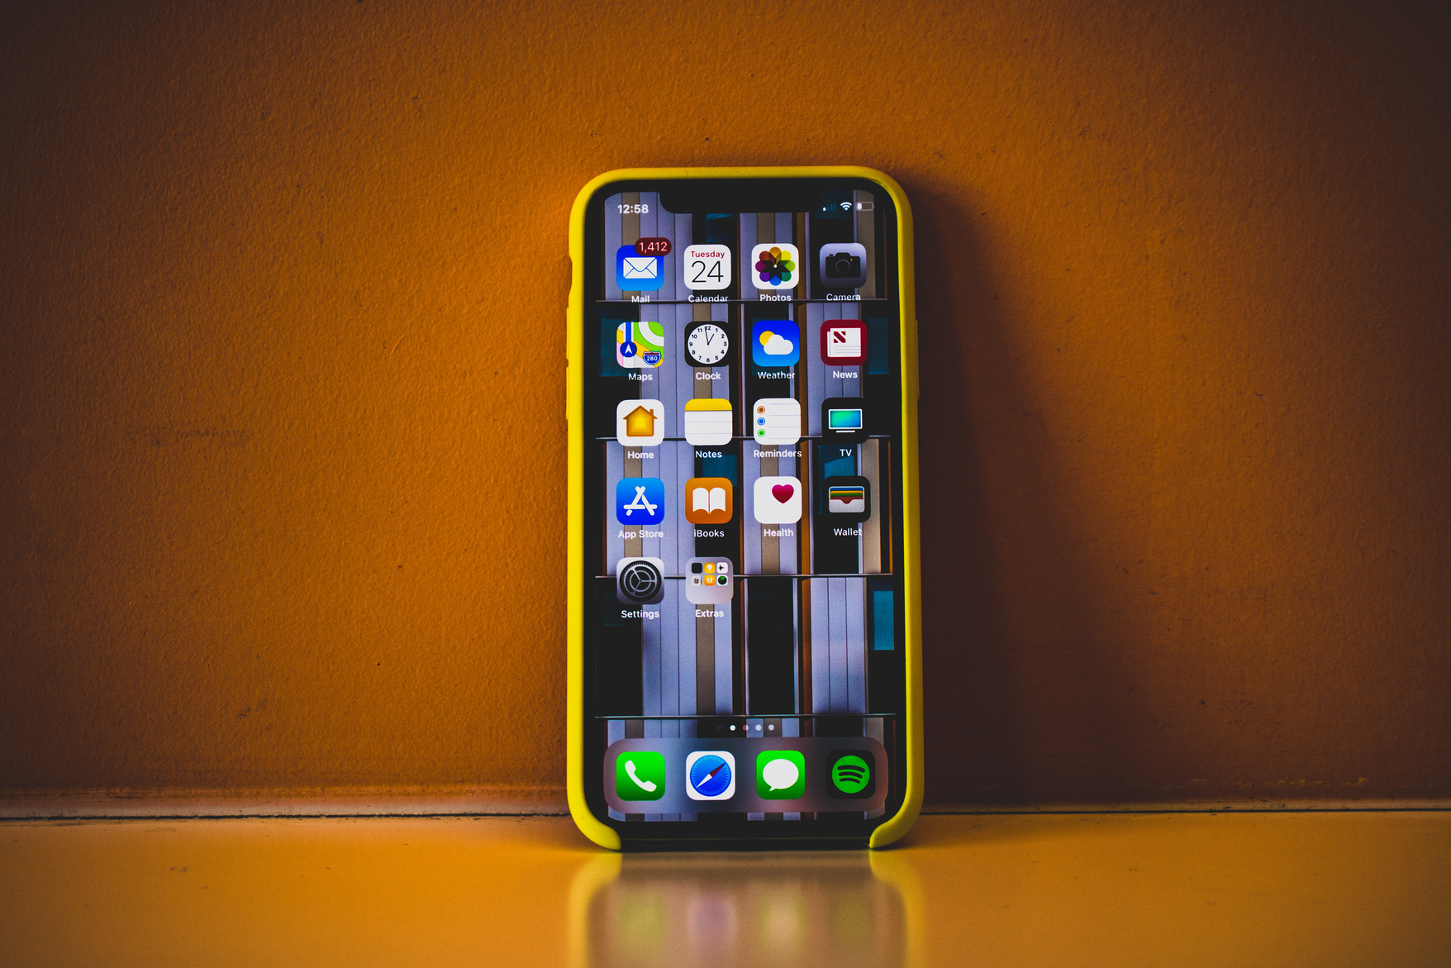
We understand the challenges businesses face in...
providing round-the-clock customer service, creating engaging content, boosting sales and marketing efforts, and staying ahead of the innovation curve.

Slide 8

That's why we have developed a comprehensive suite of ChatGPT services tailored to meet your specific needs.

Slide 9

Let's take a closer look at how our ChatGPT services can transform your business.

Slide 10

Did you know that 68% of customers expect businesses to offer real-time assistance?

Slide 11

With our ChatGPT-powered Customer Service Solution, you can provide instant support, answer FAQs, handle complaints, and ensure round-the-clock service.
All while reducing customer service expenses and improving satisfaction.

Slide 12
Content Creation is a
time-consuming task
for any business.
But with our ChatGPT services, you can supercharge
your content creation process.

Slide 13


ChatGPT reduces time, effort and resources.
Our AI-powered platform can generate drafts for blog posts, emails, newsletters, and social media updates, saving you valuable time and resources.

Slide 14
Sales and Marketing are the lifeblood of any business.
Imagine having an automated, yet personalized, assistant to interact with potential customers, pitch products or services, and follow up on leads.

Slide 15
ChatGPT boosts conversions and revenue.
With our ChatGPT services, you can enhance your sales and marketing efforts, boosting conversions and revenue.

Slide 16
Training and Onboarding new employees can be time-consuming and costly.
But with ChatGPT, we can create interactive training programs that streamline the onboarding process.

Slide 17
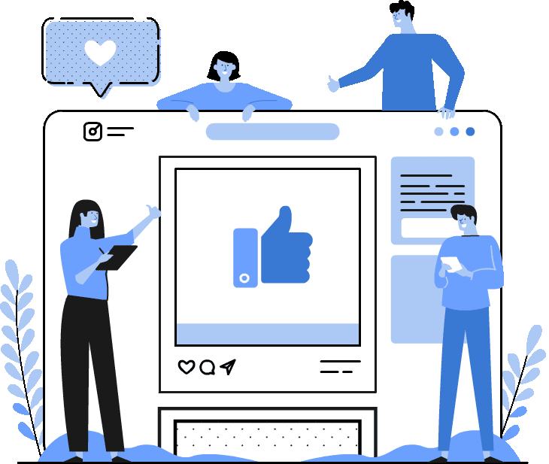
That’s the power of ChatGPT.
Our AI-powered platform ensures consistent and efficient training, reducing the time and effort required for training while empowering your workforce.

Slide 18
E-commerce Integration has become a necessity in the digital age.
With ChatGPT, we can guide your customers through product selections, make personalized recommendations, and streamline the checkout process.

Slide 19
Enhance the online shopping experience, increase customer satisfaction, and drive sales.

Slide 20
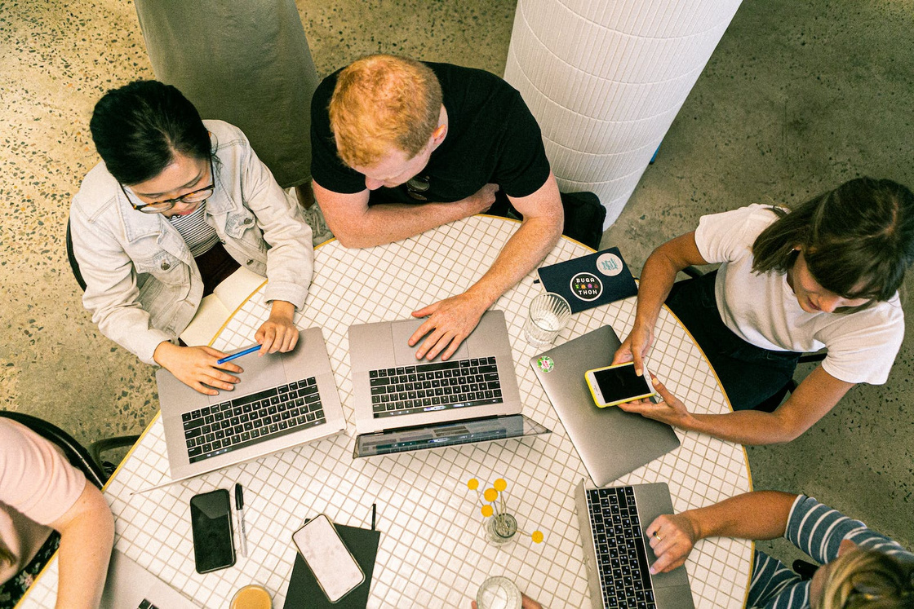

Customer feedback is invaluable for improving your products and services.
Our ChatGPT-powered Feedback Analysis solution can help you understand customer sentiment, identify key areas of concern, and provide a comprehensive summary of what your customers are saying. Harness the power of feedback to continuously enhance your offerings.

Slide 21
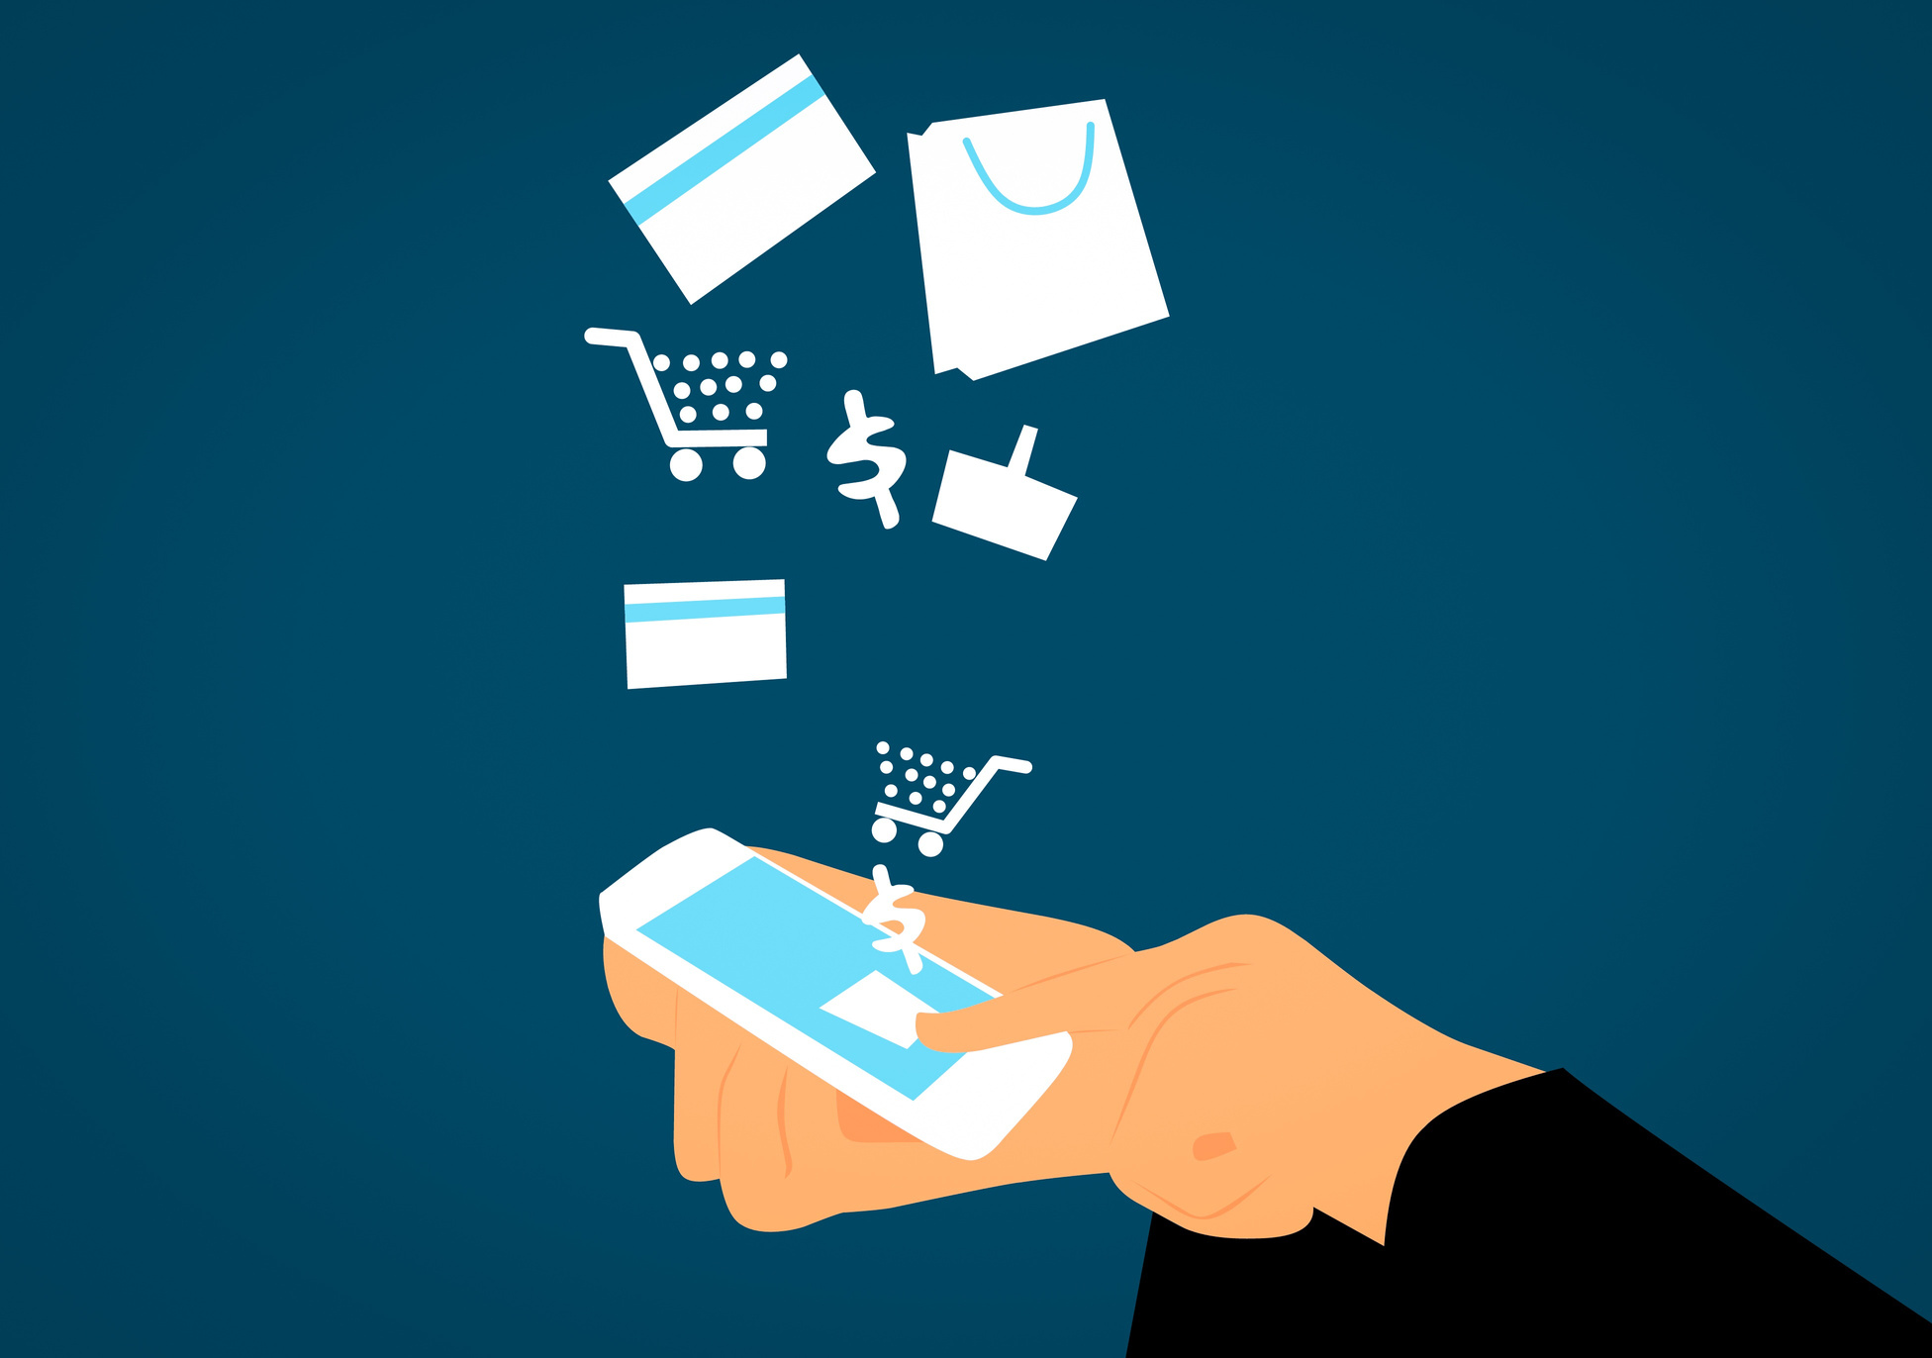
Imagine having a reliable and efficient Virtual Assistant to manage your appointments, tasks, and administrative duties.
Our ChatGPT-powered Virtual Assistant can handle it all, saving you time and allowing you to focus on what matters most – growing your business.

Slide 22
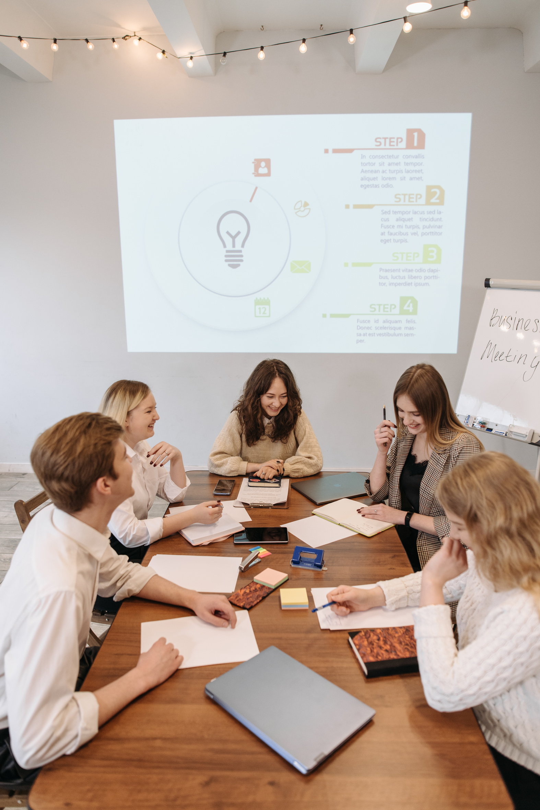
In today's global marketplace, localization is key.
Our ChatGPT services offer language understanding capabilities that can help you localize your content for different audiences. Create a more inclusive and accessible business environment, expanding your reach and fostering meaningful connections.

Slide 23
Innovation is the lifeblood of progress.
With ChatGPT, our AI-powered brainstorming tool, you can unleash your team's creativity, simulate business scenarios, and generate innovative solutions to problems.

Slide 24
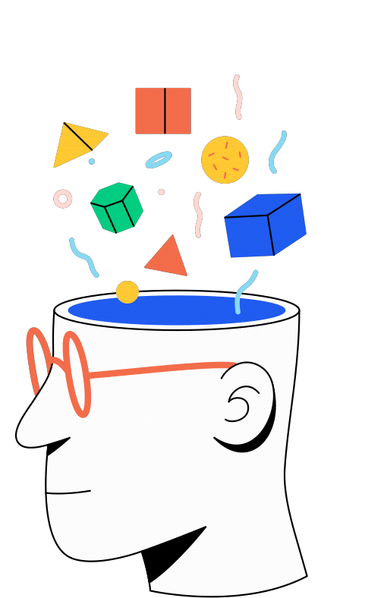
We understand that implementing ChatGPT services may seem daunting.
But worry not – we're here to handle everything for you. Simply choose the services that align with your business goals, and leave the rest to us.

Slide 25
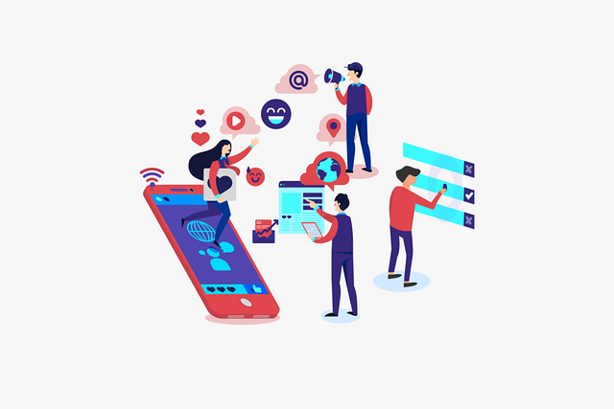
Once you've placed your order, our team will reach out to gather the necessary information and design a tailored ChatGPT solution just for you.

Slide 26
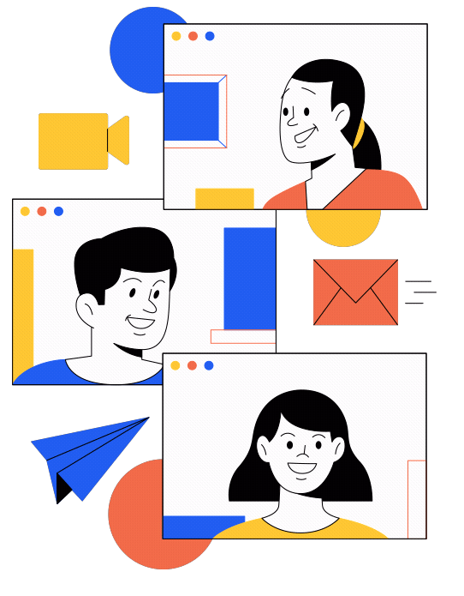
We'll handle the training, management, and ongoing support, ensuring you receive the maximum benefits from our services.

Slide 27
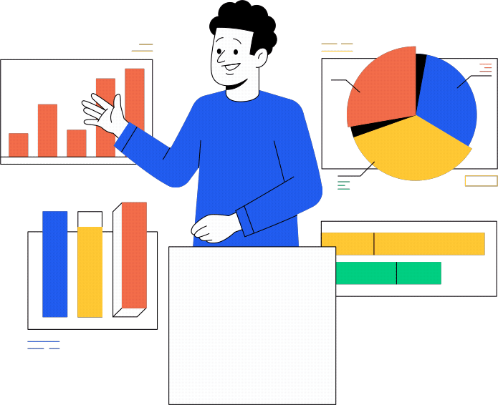
With our ChatGPT services, your business will thrive.
You'll enjoy improved customer satisfaction, increased productivity, and enhanced sales and marketing efforts. Embrace the future of customer engagement and watch your business reach new heights.

Slide 28

Easily Increase Engagement!
Also ChatGPT can increase engagement with your target audience by providing them with instant responses of relevant information, and creating unique content, that keeps them interested in your brand.

Slide 29

Nurture Leads...
Not to mention, you can nurture leads by using ChatGPT and the services we provide and move them closer to a purchase.

Slide 30
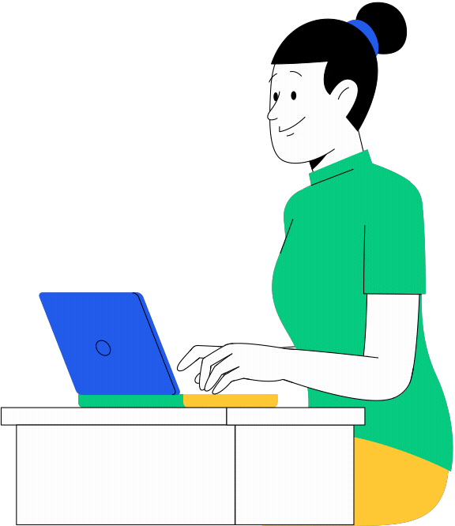
Standout From The Competition...
In a crowded market, unique and valuable content, instant and helpful responses and giving your customers the services they want and deserve can help differentiate your business from the competition and make customers want to do business with you.
All this can be achieved and automated with ChatGPT

Slide 31

Encourage Social Sharing...
Plus, the content that ChatGPT will create for you will encourage social sharing and increase social media engagement and exposure for your brand.

Slide 32

So why wait?
Click the button on this page today and unlock the endless possibilities of ChatGPT for your business. We are your trusted partner for digital transformation.
Let's get started today!

